Slide 1
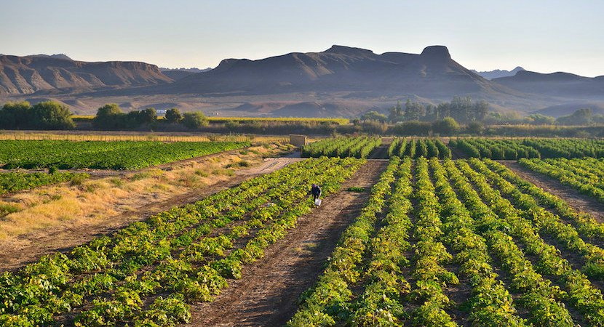
IMPORT PROCEDURES FOR PLANTS AND PLANT PRODUCTS
National Sanitary and Phytosanitary Workshop
10 March 2021
PRESENTED BY: MS NOKUTHULA CELE
DEPUTY DIRECTOR: REGULATORY SERVICE DESK
DIRECTORATE: FOOD IMPORT AND EXPORT STANDARDS

Slide 2
PRESENTATION OUTLINE
Introduction
Legislative Framework
General Import procedures
Application form and tariffs
Port of Entry procedures
Challenges and Recommendations
Contact Information

Slide 3
Importation of PLANTS AND PLANT products
Introduction
DALRRD is responsible for the management of risks associated with plant pests and diseases
Legislative Framework
Agricultural Pests Act, 1983 (Act No. 36 of 1983) (APA) and its subordinate legislations as amended
1. Regulations R.111 of 27 January 1984
Provides for the importation of plants, plant products and other regulated articles by means of import permit
2. Government Notices R.1013 of 26 May 1989; provides for the importation of controlled goods without a permit, subject to requirements stipulated in that notice.

Slide 4
Importation of PLANTS AND PLANT products
Legislative Mandate continued
The aim of the Act is to provide for measures by which agricultural pests may be prevented and combated and for matters connected therewith. The Act also mandates the National Plant Protection Organization of South Africa (NPPOZA) to regulate plants, plant products and other regulated articles when imported into South Africa.
The Agricultural Pests Act and the above Regulations may be obtained from the following link:- https://www.dalrrd.gov.za/Branches/Agricultural-Production-Health-Food-Safety/Plant-Health/National-Control-Measures/Legislations-and-Regulations

Slide 5
Importation of PLANTS AND PLANT products
Legislative Mandate continued
Section 3(1) of the Agricultural Pests Act, 1983 (Act No. 36 of 1983) states that
“no person shall import into the Republic
any plant, pathogen, insect, exotic animal, growth medium, infectious thing, honey, beeswax or used apiary equipment;
anything determined by the Minister by notice in the Gazette, except on the authority of a permit”.
It is therefore a requirement to apply for an import permit for controlled well in advance in cases where it is required.

Slide 6
Importation of PLANTS AND PLANT products
Import procedures
Enquire with the National Plant Protection Organization of South Africa (NPPOZA) whether a phytosanitary import permit is required or not required.
Apply for an import permit if the commodity to be imported is not exempted in terms of Government Notices R.1013 of 26 May 1989.
Ensure compliance with phytosanitary measures if the commodity to be imported is exempted from an import permit.
Ensure compliance with phytosanitary import requirements that must be complied with in case a permit is required in terms of Regulations R.111 of 27 January 1984

Slide 7
Importation of PLANTS AND PLANT products
Import procedures continued
Forward a copy of the import permit to the exporter or supplier in the exporting country to ensure that the consignment to be exported meets the phytosanitary import requirements of South Africa.
Ensure that the exporter or supplier presents the commodity to be imported to the National Plant Protection Organization (NPPO) of the exporting country for phytosanitary inspection and certification where necessary in terms of the permit and/or exemption requirements.
Inform the exporter or supplier to send the original phytosanitary certificate with the consignment to South Africa (if a phytosanitary certificate is required).

Slide 8
Importation of PLANTS AND PLANT products
Application Form and Tariffs
Complete the CORRECT application form in block letters, legibly and in full and make the CORRECT payment of the tariff prescribed.
The application form can be obtained from:- https://www.dalrrd.gov.za/Branches/Agricultural-Production-Health-Food-Safety/Plant-Health/Import-into-SA
The completed application form together with proof of payment must be emailed to PlantHealthPermits@Dalrrd.gov.za.
Applications must be submitted at least 30 days prior to the date of arrival of the goods in the Republic.
In cases where phytosanitary import conditions are not in place, the application will be routed to the Directorate: Plant Health for Pest Risk analysis .

Slide 9
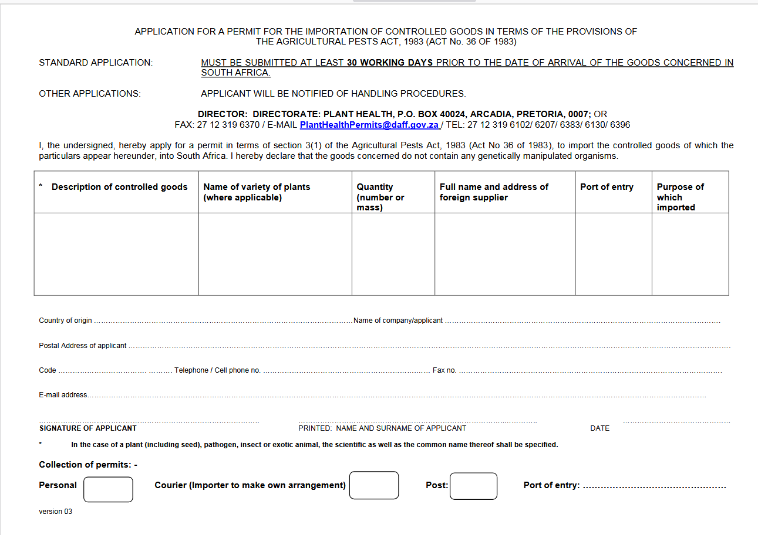

Slide 10
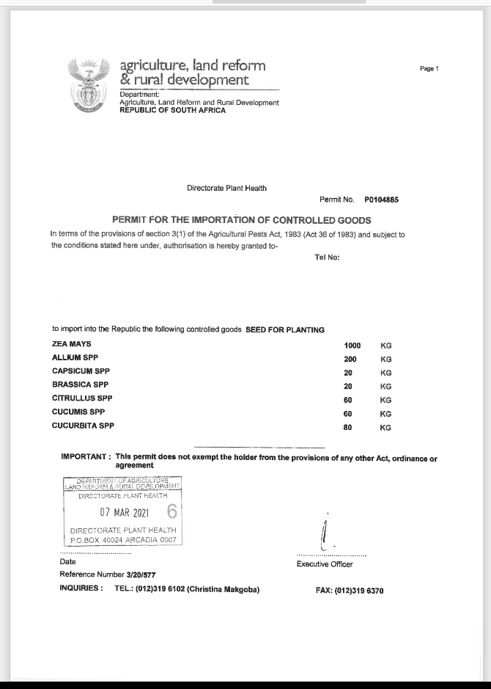

Slide 11
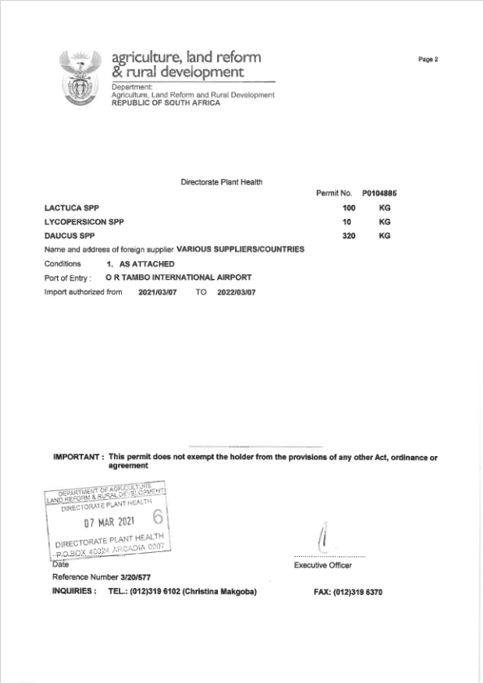

Slide 12
Banking details-PHYTOSANITARY IMPORT PERMITS
Name of Bank: STANDARD BANK OF SOUTH AFRICA
Account Holder : DAFF: Import of controlled Goods
Account Number: 011251735
Branch Code: 010845
Branch Name: ARCADIA
Reference: Importers Name & Surname / Company Name
Payments can also be made at the Departments Cashiers.

Slide 13
Importation of PLANTS AND PLANT products
Port of Entry Procedures
The following must be presented to the Executive Officer at the port of entry:
Phytosanitary Import Permit where applicable
Original Phytosanitary Certificate where applicable
Any other documentation specified e.g.: The Customs Declaration Form (SAD 500), packing list etc…

Slide 14
CHALLENGES
RECOMMENDATIONS
Incomplete applications
Unsigned applications
Incorrect payment
Incorrect company name
Incorrect info with enquiries
Incorrect email address
Delays from post office
Delayed enquiries
Late / Emergency applications
Renewal applications
Complete as per application form, ask for clarity where necessary
Please sign and date application
Enquire and ensure correct payment is made and sent with application form
Company name cannot be amended, Use correct name or pay & apply for a new permit
Please follow up with correct details
Please ensure email address on application is valid
Use a Courier company
Follow up
APPLY WELL IN ADVANCE TO IMPORTATION
Are regarded as new application due to the permit has expired- normal application process to be followed

Slide 15
CONTACT Information
NAME | DESIGNATION | CONTACT | E-MAIL
Ms. Christina Makgoba | Chief Plant Health Officer | 012 319 6102 060 9733481 | PlantHealthPermits@Dalrrd.gov.za
Ms. Nokuthula Cele | Deputy Director- Regulatory Service Desk | 012 319 6313 060 973 4078 | ThuleN@Dalrrd.gov.za
Thank you

